Slide 1
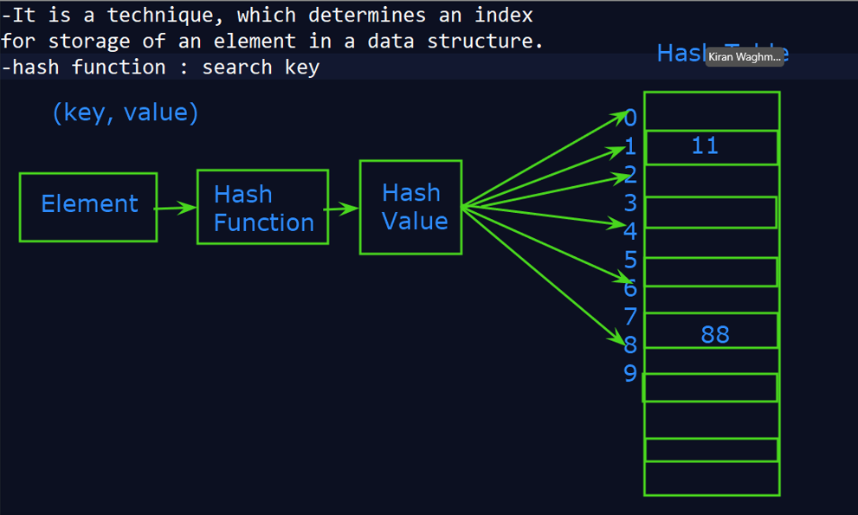

Slide 2
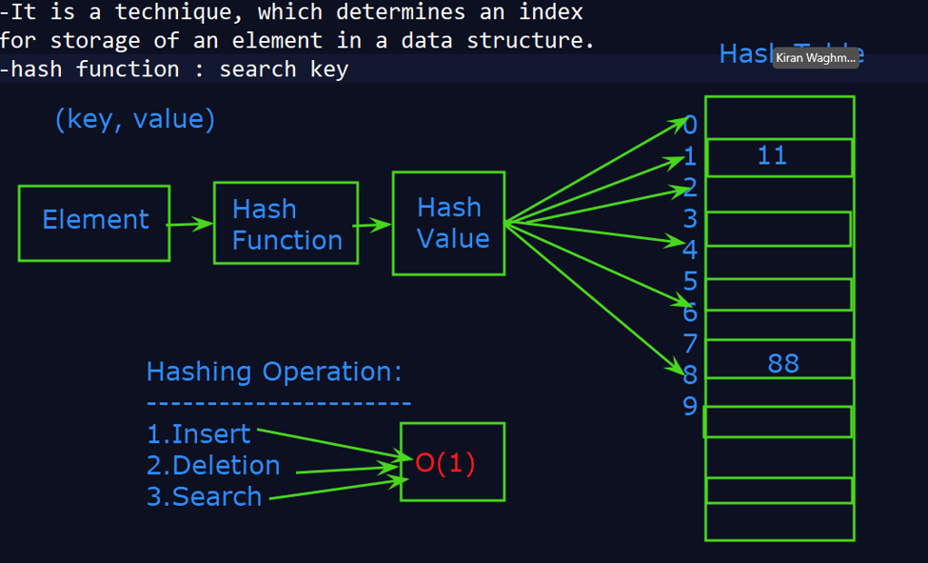

Slide 3
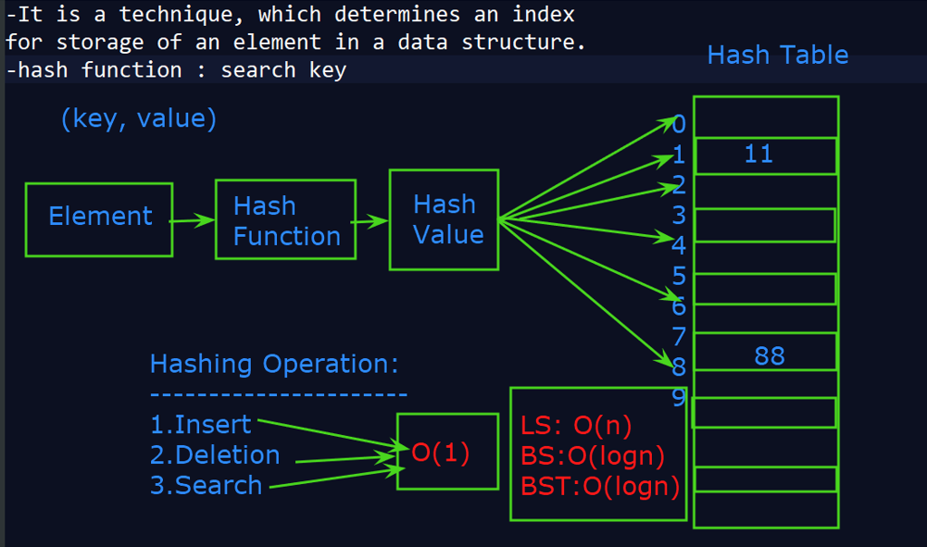

Slide 4
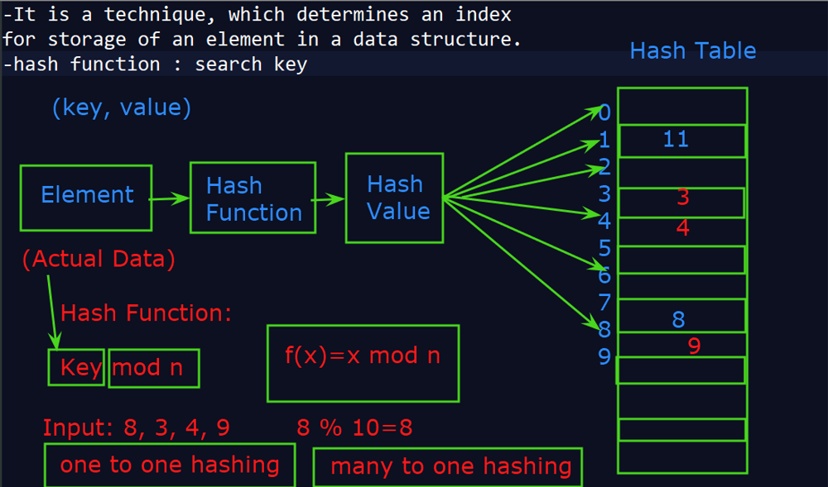

Slide 5
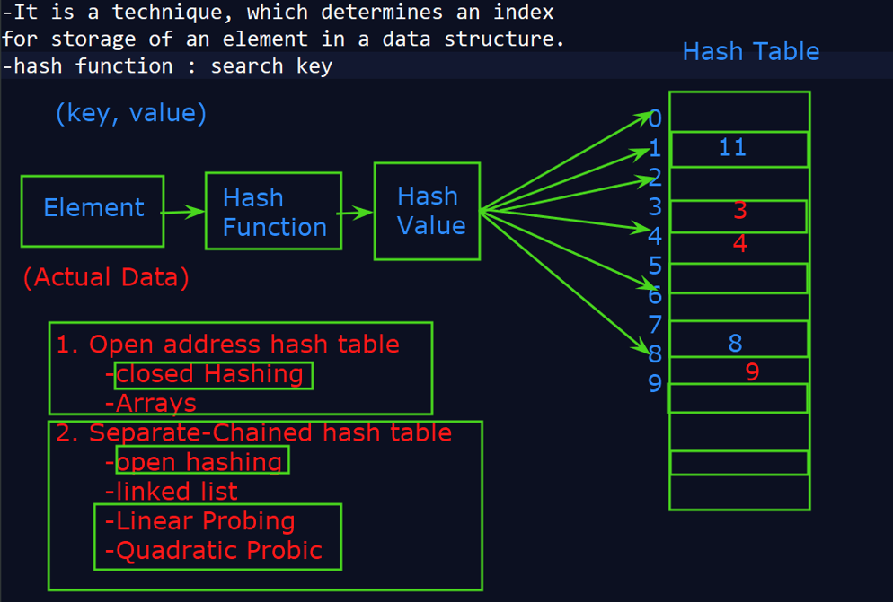

Slide 6
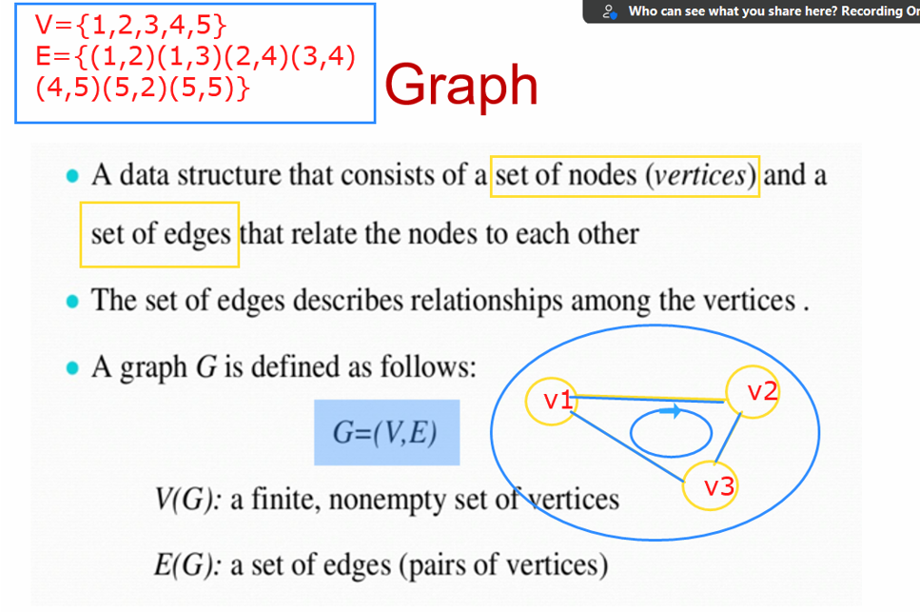

Slide 7
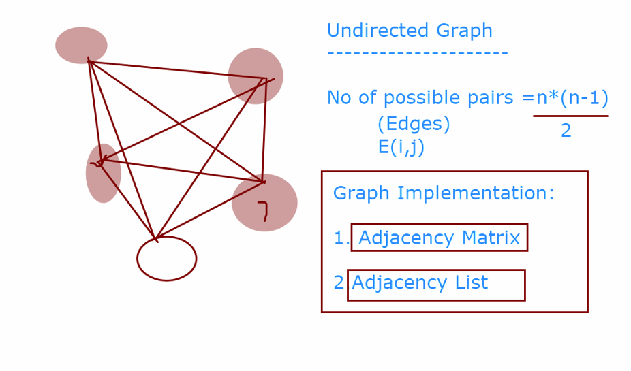

Slide 8
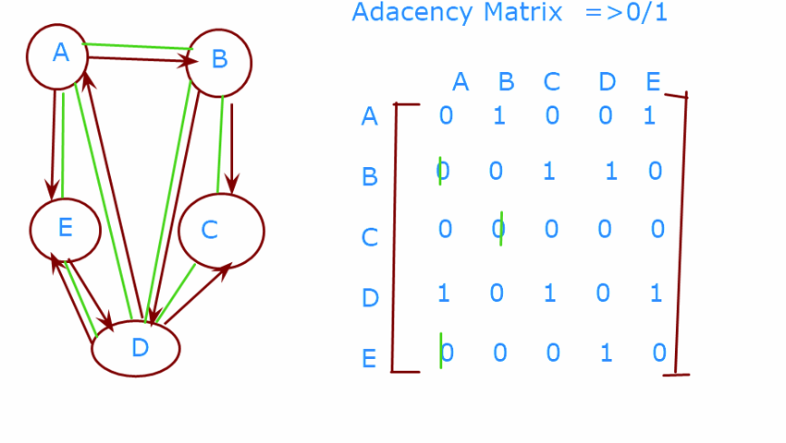

Slide 9
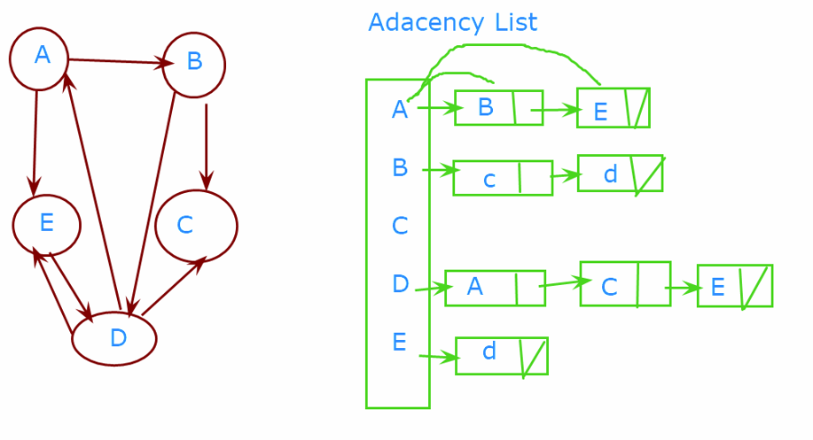

Slide 10
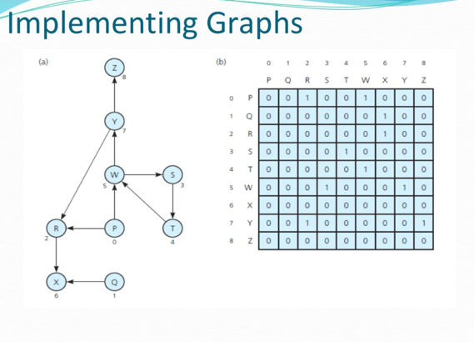

Slide 11
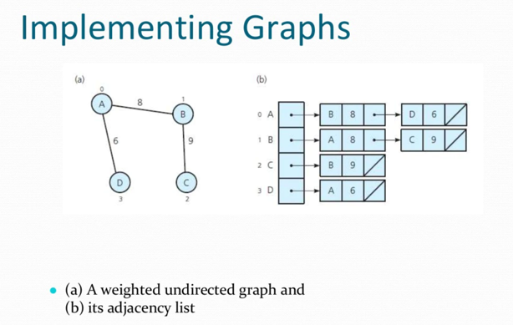

Slide 12
Reachability: exploring a maze
L
K
F
H
B
E
C
G
J
I
A
D
D
A
B
E
G
H
C
F
I
J
K
L
Which vertices of the graph are reachable from a given vertex?

Slide 13
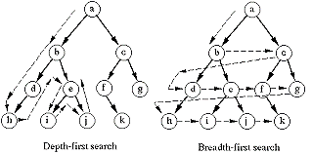

Slide 14
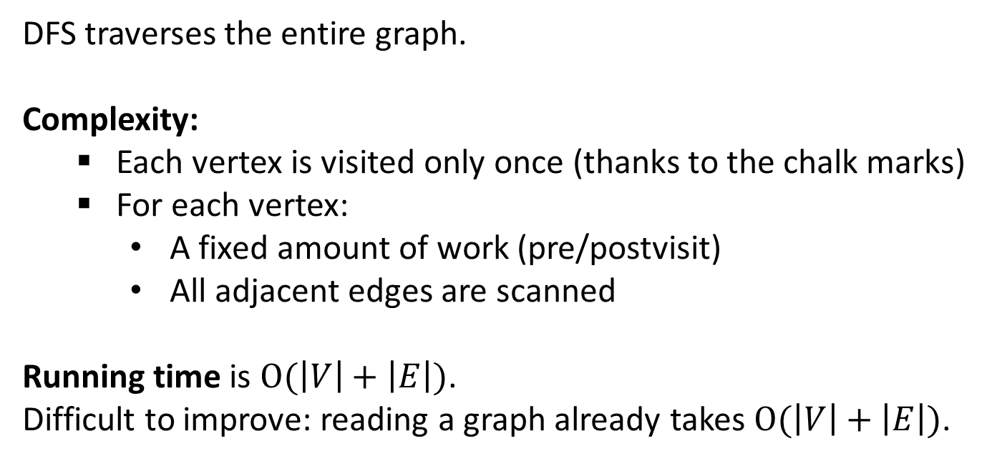
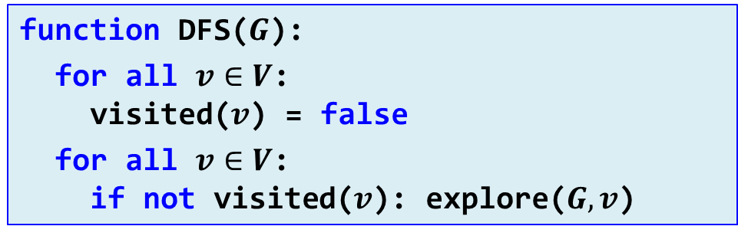
Depth-first search
function DFS($G$):
for all $v∈V$: visited($v$) = false
for all $v∈V$: if not visited($v$): explore($G, v$)
DFS traverses the entire graph.
Complexity:
Each vertex is visited only once (thanks to the chalk marks)
For each vertex:
A fixed amount of work (pre/postvisit)
All adjacent edges are scanned
Running time is $\text{O}(\left|V\right|+\left|E\right|)$. Difficult to improve: reading a graph already takes $\text{O}(\left|V\right|+\left|E\right|)$.

Slide 15
BFS algorithm
function BFS($G$, $s$) // Input: Graph $G(V,E)$, source vertex $s$. // Output: For each vertex $u$, dist[$u$] is // the distance from $s$ to $u$. for all $u∈V$: dist[$u$]=$∞$ dist[$s$] = 0 Q = {$s$} // Queue containing just $s$ while not Q.empty(): $u$ = Q.pop_front() for all $\left(u,v\right)∈E$: if dist[$v$] = $∞$: dist[$v$] = dist[$u$] + 1 Q.push_back($v$)
Runtime $\text{O}(\left|V\right|+\left|E\right|)$: Each vertex is visited once, each edge is visited once (for directed graphs) or twice (for undirected graphs).

Slide 16
Reachability: BFS vs. DFS
Input: A graph $G$ and a source node $s$. Output: $∀u∈V:$ reached[$u$] $⇔$ $u$ is reachable from $s$.
function BFS($G$, $s$) for all $u∈V$: reached[$u$] = false Q = // Empty queue Q.push_back($s$) reached[$s$] = true while not Q.empty(): $u$ = Q.pop_front() for all $\left(u,v\right)∈E$: if not reached[$v$]: reached[$v$] = true Q.push_back($v$)
function DFS($G$, $s$) for all $u∈V$: reached[$u$] = false S = // Empty stack S.push($s$) while not S.empty(): $u$ = S.pop() if not reached[$u$]: reached[$u$] = true for all $\left(u,v\right)∈E$: if not reached[$v$]: S.push($v$)

Slide 17
Finding Minimum Spanning Trees
1. Kruskal’s algorithm,
2. Prim’s algorithm

Slide 18
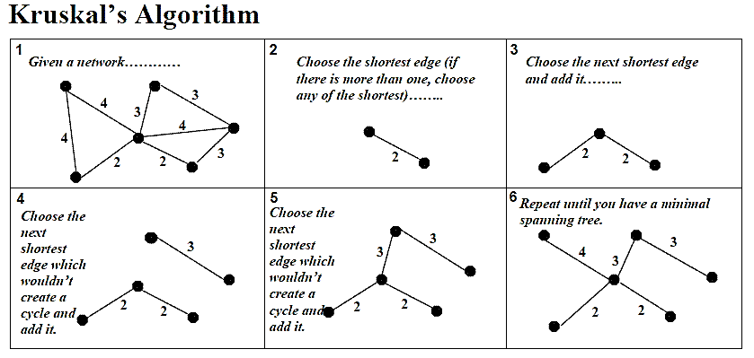

Slide 19
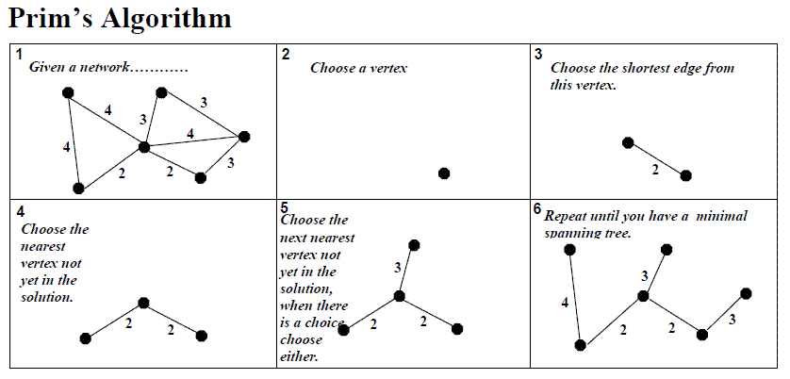

Slide 20
Dijkstra’s algorithm: invariant
12
12
7
D
7
D
5
5
A
8
A
8
10
13
13
E
…
3
11
E
…
3
11
E
0
0
B
B
2
S
5
F
S
5
F
5
13
F
8
8
H
7
7
C
C
G
4
G
4
11
11
Shortest paths already computed (completed vertices)
Frontier
Data structure:
The set of non-completed vertices with their shortest distance from S using only the completed vertices.

Slide 21
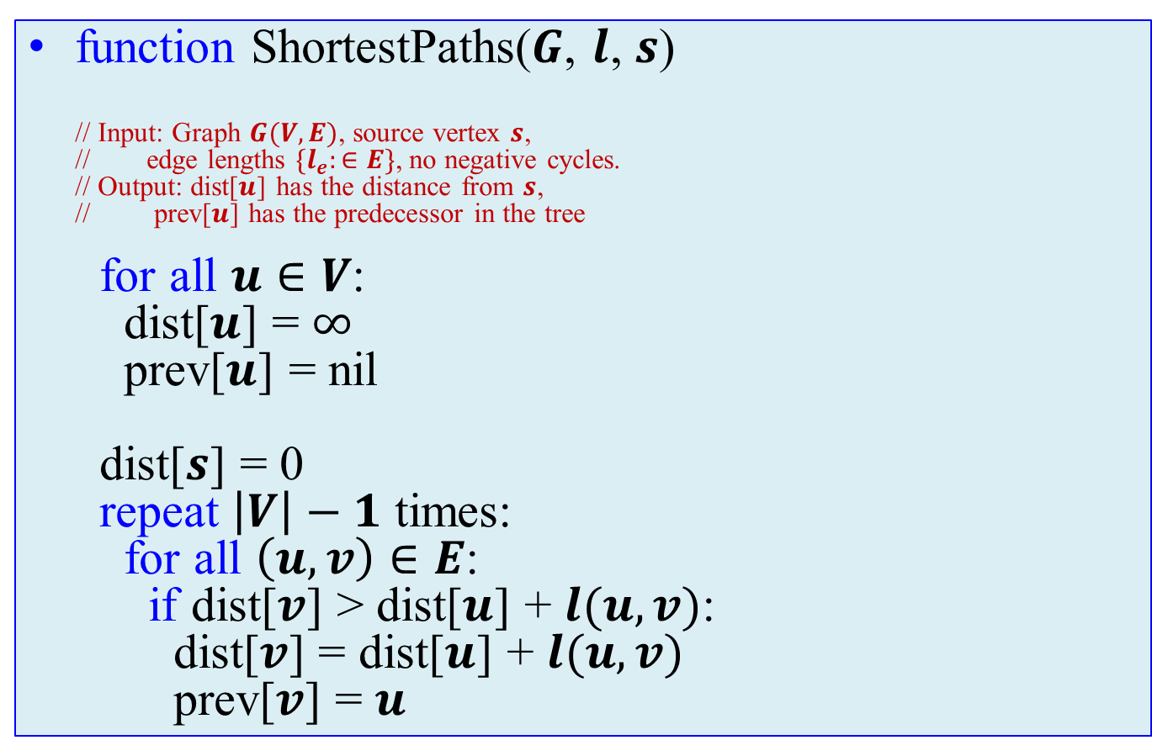
Bellman-Ford algorithm
function ShortestPaths($G$, $l$, $s$) // Input: Graph $G(V,E)$, source vertex $s$, // edge lengths ${\{l}_{e}:∈E\}$, no negative cycles. // Output: dist[$u$] has the distance from $s$, // prev[$u$] has the predecessor in the tree for all $u∈V$: dist[$u$] = $∞$ prev[$u$] = nil dist[$s$] = 0 repeat $\left|V\right|−1$ times: for all $\left(u,v\right)∈E$: if dist[$v$] > dist[$u$] + $l(u,v)$: dist[$v$] = dist[$u$] + $l(u,v)$ prev[$v$] = $u$

